Slide 1
Movie rental data analysis
Harsh Kumar Gupta

Slide 2
CONTENTS
Objective
Introduction
Business Problems
Analysis
Summary

Slide 3
Objective
Use MySql to find the movies that are most popular and help the business in it growth

Slide 4
INTRODUCTION
Movie Rental Data Analysis MovieOnRent is a chain of movie rental stores operating in a certain country. It has a vast collection of movies in DVD and Blue Ray disc formats. The management of the company wants to analyze what kind of movies are most often rented, which genres they belong to, and which actors appeared in them. It will help the management stock up the inventory as per audience's preferences for improved business.

Slide 5
Business Problems
Display the full names of actors available in the database.
Display the number of times each first name appears in the database.
What is the count of actors that have unique first names in the database? Display the first names of all these actors.
3.
Display the number of times each last name appears in the database.
Display all unique last names in the database.
4.
Display the list of records for the movies with the rating "R".
Display the list of records for the movies that are not rated "R".
Display the list of records for the movies that are suitable for audience below 13 years of age.
5.
Display the list of records for the movies where the replacement cost is up to $11.
Display the list of records for the movies where the replacement cost is between $11 and $20.
Display the list of records for the all movies in descending order of their replacement costs
6. Display the names of the top 3 movies with the greatest number of actors.
7. Display the titles of the movies starting with the letters 'K' and ‘Q’
8. Display the names of all actors who appeared in the film “Agent Truman”.
9. Identify all the movies categorized as family films.
10.
Display the maximum, minimum, and average rental rates of movies based on their ratings. The output must be sorted in descending order of the average rental rates.
Display the movies in descending order of their rental frequencies, so the management can maintain more copies of those movies.
11. In how many film categories, the difference between the average film replacement cost ((disc - DVD/Blue Ray) and the average film rental rate is greater than $15?
Display the list of all film categories identified above, along with the corresponding average film replacement cost and average film rental rate.
12. Display the film categories in which the number of movies is greater than 70.

Slide 6
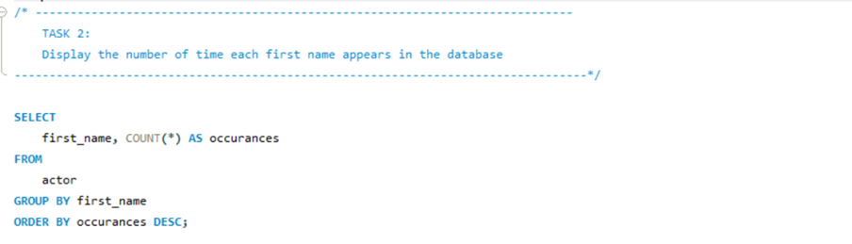
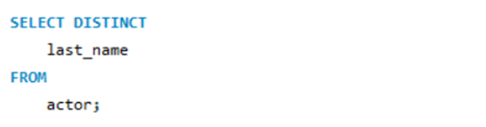
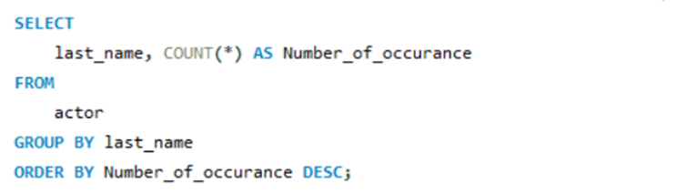
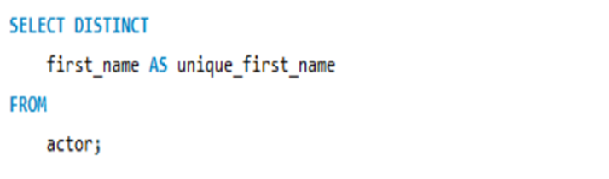
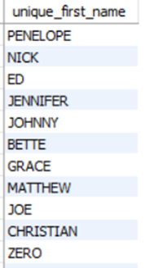
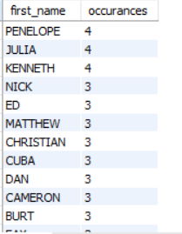
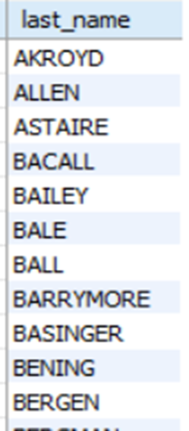
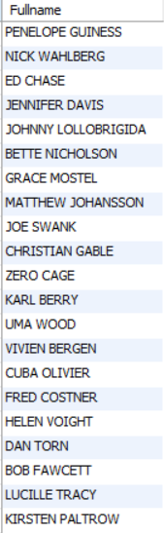
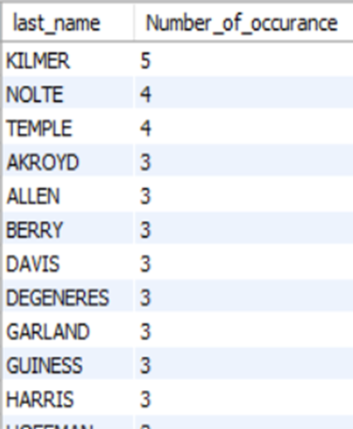
1
2
3
Display the number of times each first name appears in the database.
What is the count of actors that have unique first names in the database? Display the first names of all these actors.
Display the number of times each last name appears in the database.
Display all unique last names in the database.
TASK 1: Display the full names of actors available in the database.
QUERY
QUERY
QUERY
QUERY
QUERY
OUTPUT
OUTPUT
OUTPUT
OUTPUT
OUTPUT
There are a total of 200 actors.
There are a total of 128 unique first names
Penelope ,Julia and Kenneth are the most occurring first names which are repeated 4 times
There are a total of 121 unique last names
KILMER is the last name which occurs the most number of times (5 times)

Slide 7
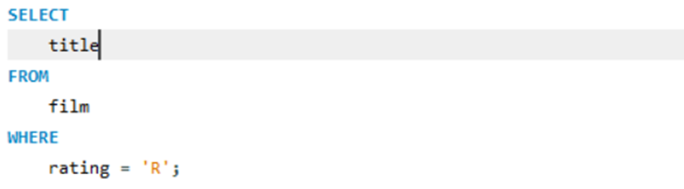
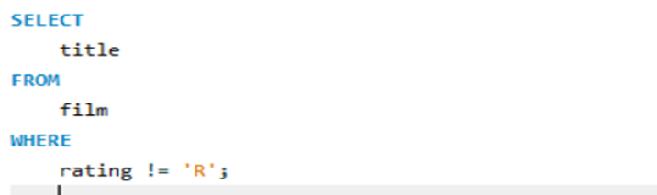
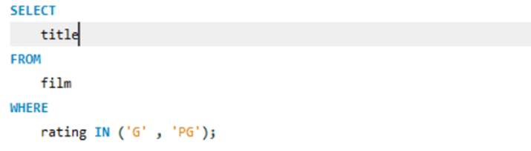
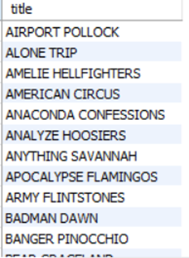
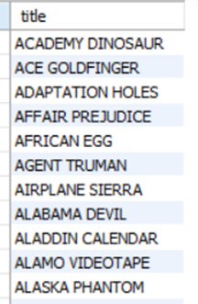
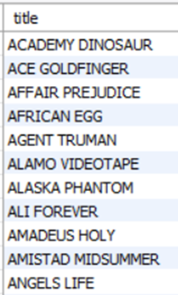
4
Display the list of records for the movies with the rating "R".
Display the list of records for the movies that are not rated "R".
Display the list of records for the movies that are suitable for audience below 13 years of age.
QUERY
QUERY
QUERY
OUTPUT
OUTPUT
OUTPUT
There are a total of 128 movies that are rated ‘R’
There are a total of 805 movies that are not rated ‘R’
There are a total of 372 movies that are suitable for children below 13

Slide 8
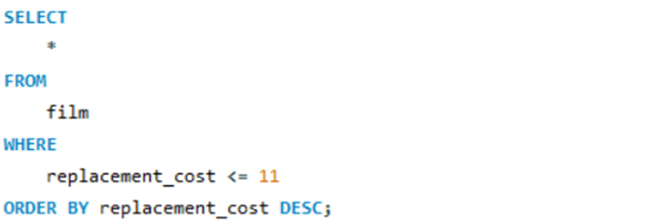
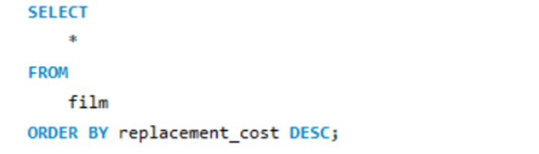
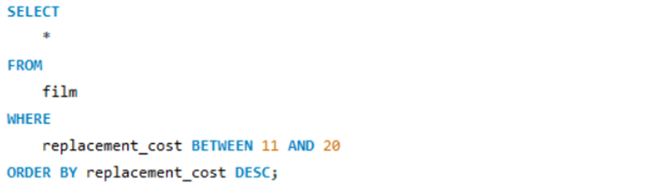
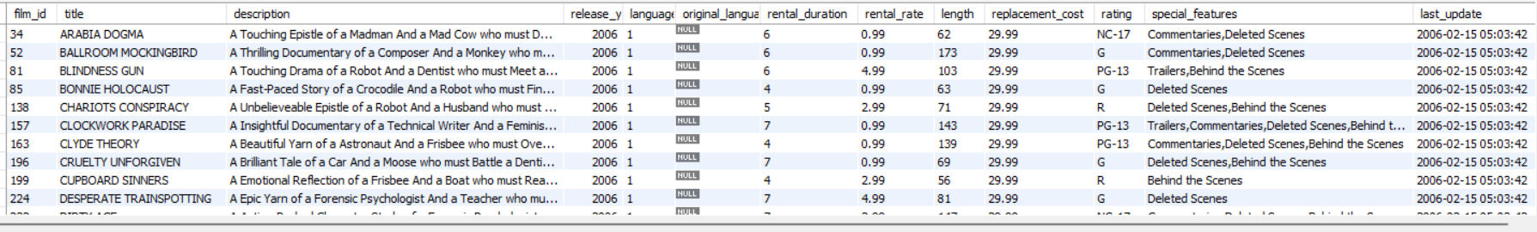
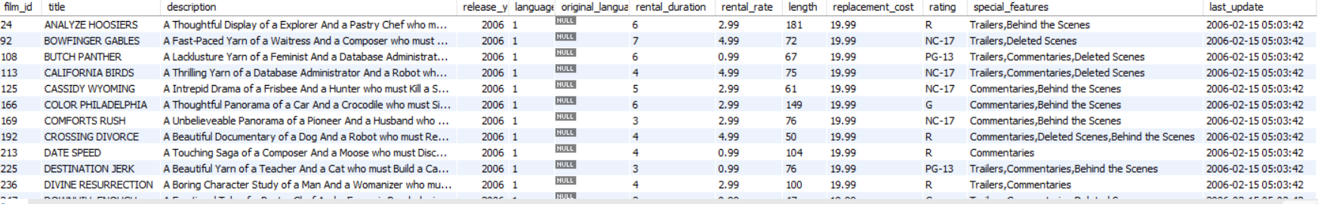
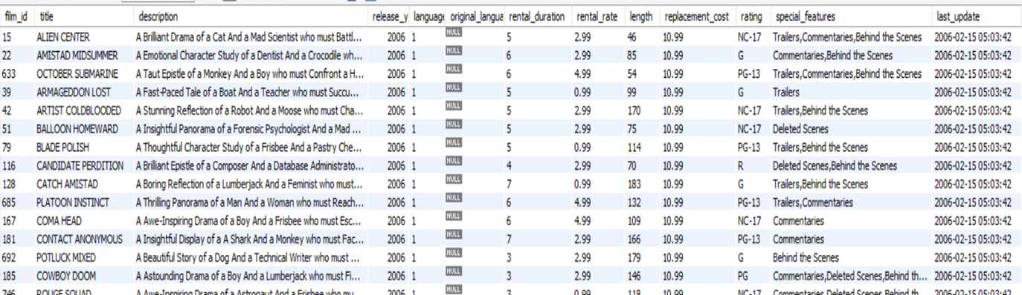
5
Display the list of records for the movies where the replacement cost is up to $11.
Display the list of records for the movies where the replacement cost is between $11 and $20.
Display the list of records for the all movies in descending order of their replacement costs
QUERY
QUERY
QUERY
OUTPUT
OUTPUT
OUTPUT
There are a total of 90 movies whose replacement cost is upto t$11
The highest replacement cost is 29.99 and movies like Arabia Dogma has the highest replacement cost
There are 424 movies satisfy the condition

Slide 9
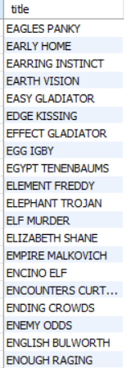
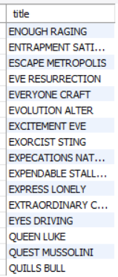
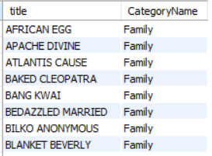
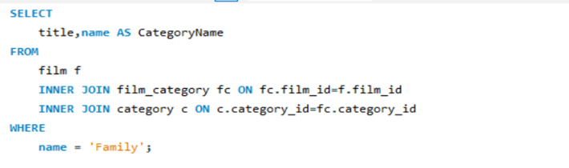
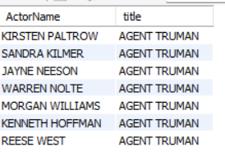

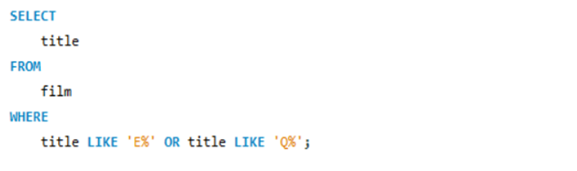
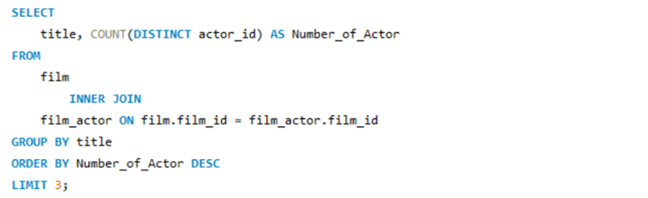
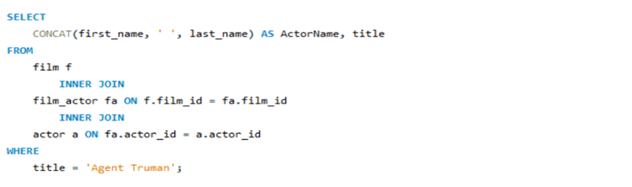
9
8
6
7
Identify all the movies categorized as family films.
Display the names of all actors who appeared in the film “Agent Truman”.
Display the names of the top 3 movies with the greatest number of actors.
Display the titles of the movies starting with the letters 'K' and ‘Q’
OUTPUT
OUTPUT
OUTPUT
QUERY
OUTPUT
QUERY
QUERY
QUERY
The highest number of actor in a movie is 15.
The three movies with highest number of actors are: LAMBS CINCINATTI, CHIITY LOCK and BOONDOCK BALLROOM
There are 69 such movies
There are a total of 35 such movies: 32 movies start with K
3 movies start with Q
There are 7 actors in the movies Agent Truman

Slide 10
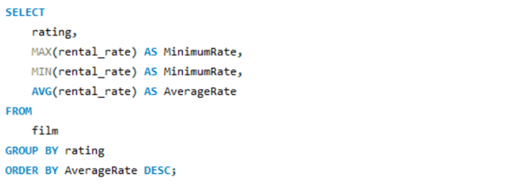
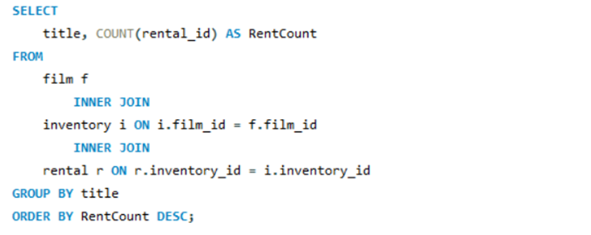
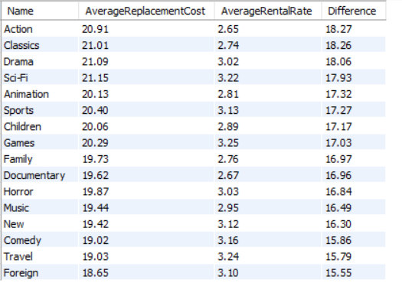
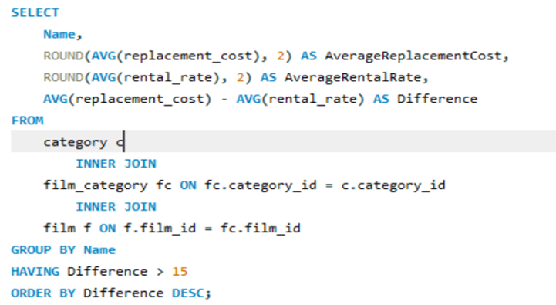
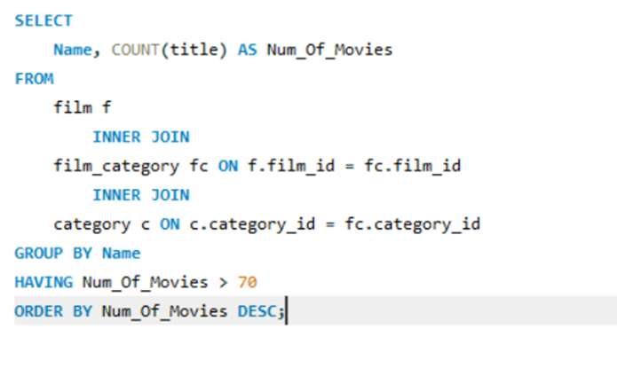

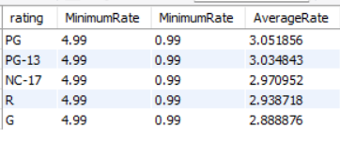
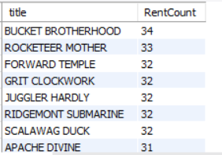
11
12
10
Display the list of all film categories identified above, along with the corresponding average film replacement cost and average film rental rate and sort the difference between them in descending.
Display the film categories in which the number of movies is greater than 70.
Display the maximum, minimum, and average rental rates of movies based on their ratings.
Display the movies in descending order of their rental frequencies.
QUERY
QUERY
OUTPUT
QUERY
OUTPUT
QUERY
OUTPUT
OUTPUT
There are 69 such movies
The sports and Foreign are the only two category which have more than 70 movies
PG rating has the highest average rating
The movie BUCKET BROTHERHOOD has the most number of rents (34 rents)

Slide 11
SUMMARY
Approximately one-third of the movies are suitable for children below the age of 13
Sports and Foreign category has most number of movies
The highest replacement cost is 29.99
There are 90 movies having replacement cost below 11
There are around 459 movies replacement cost between $ 11 to $ 20
Most number of movies have replacement cost above $ 20
The number of movies in Family category should be increased

Slide 12
THANK YOU

